Slide 1
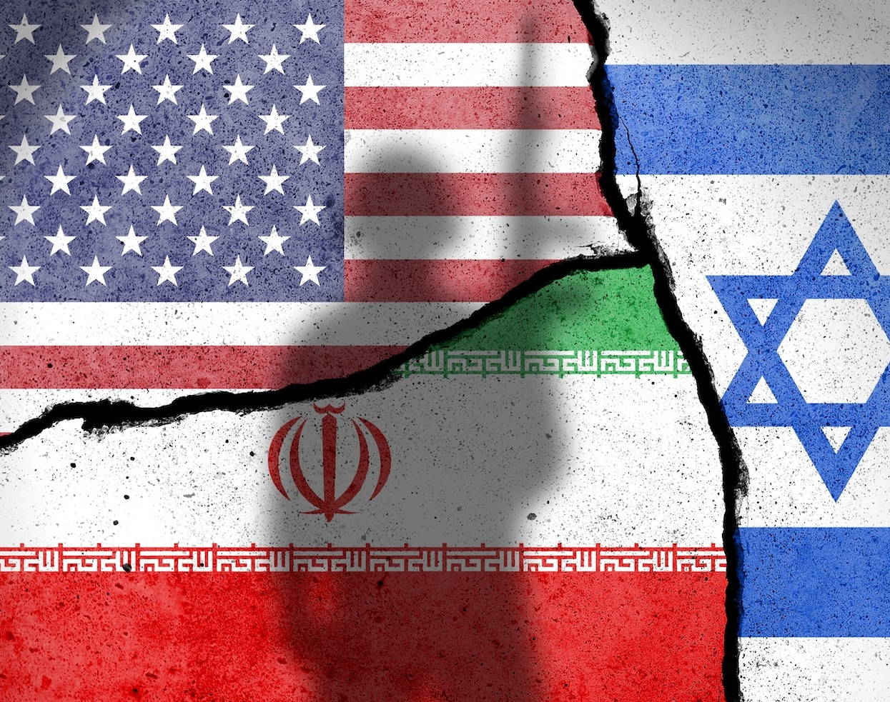
Profiteers and Sick Leaders:
Understanding the Iran War
Brian D’Agostino, Ph.D. bdagostino.com

Slide 2
Irrationality of War
Two Layers, Structural and Psychological
  #1 Political-Economic Structure: The Trillion Dollar War Machine
  #2: Sociopathic Leaders and Their Enablers: Not all leaders and not a majority of the mass public
The Interaction: Pathological leaders are primarily enabled by special interests who thrive on war
  Weapons manufacturers
  Oil companies
  Wealthy donors with ideological or religious/nationalist agendas

Slide 3
Think Tanks:
The Propaganda Machine
Think tanks that promoted war with Iran
  The Atlantic Council
  Center for New American Security
  The Aspen Institute
  American Israel Public Affairs Committee (AIPAC)
Who funded them?
  Weapons manufacturers (e.g. Northrup Grumman)
  Foreign governments (e.g. United Arab Emirates)
  Wealthy political donors (e.g. Miriam Adelson)

Slide 4
Psychopathology of Benjamin Netanyahu
Shaul Kimhi et al (2017), Annals of Psychiatry and Mental Health; stable personality features across 1999 and 2017 behavioral analyses:
Habitual lying and breaking promises
Narcissism, paranoia and sense of victimhood
Demands loyalty but doesn’t practice it
Makes decisions impulsively and without consulting others
Never acknowledges mistakes or apologizes
Dominates others; inability to practice reciprocity

Slide 5
Netanyahu and Iran
Says he has wanted war with Iran for over forty years
Sabotaged 2016 Iran Nuclear Deal (JCPOA), which prevented Iranian acquisition of nuclear weapons
Believed Iranian regime would collapse if Israel attacked; Mossad director Yossi Cohen pushed back on this delusion
In 2021, Netanyahu replaced Cohen with David Barnea, who told him what he wanted to hear (compare G. W. Bush on Iraq WMD)
February 28 Israeli-US attack on Iran: produced no regime change, but widespread destruction in Middle East and damage to world economy

Slide 6
Psychopathology of Donald Trump
Bandy X. Lee, ed. The Dangerous Case of Donald Trump (2017); The Psychology of Trump Contagion (2024); stable personality features:
Proclivity to violence and threats of violence
Intolerable childhood trauma drives alternative, delusional reality aggrandizing himself
Needs to achieve power to confirm his alterative reality;
Syndrome replaces normal pattern of learning about and adapting to reality

Slide 7
Trump and Iran
Withdrew from Iran Nuclear Deal (JCPOA) to destroy Obama’s greatest foreign policy accomplishment
With Netanyahu, entertained delusion that attacking Iran would cause regime to collapse
U.S. national security professionals warned Trump that Iranian regime would not collapse, and US would not achieve its other objectives through war
Trump now wants to end the war, but won’t accept Iran’s terms, which show that he failed

Slide 8
Building a More Humane Future
Need to demilitarize US economy and state; need to invest instead in sustainable prosperity
Can’t expect leadership from either political party; need grassroots movement demanding sane national priorities
To overcome psychopathology, need to support parenting education; can interrupt transgenerational cycle of interpersonal and societal violence

Slide 9
Parenting Education Resources
D’Agostino (2023), pp. 337-338
H. van de Rijt and F. Plooij (2017), The Wonder Weeks
Home visiting programs for post-partum doulas and pediatric nurses (to support healthy attachment and parents’ capacity for mentalization/reflective function).
M. Kind (2014), “Teaching Parenting in Schools” Psychohistory News Vol. 33, No. 3 (Summer) psychohistory.us
PEPS Magazine (in French); supports positive parenting regardconscient.net/newsletter/accueil-peps.html
Parents First!, an educational organization that supports parenthood parentsfirst.net

Slide 10
References
D’Agostino, Brian (2023). Sources and dynamics of the self: Perceptual control theory, psychoanalysis, and the control of self-image. In Mansell, Warren et al, eds. Interdisciplinary Handbook of Perceptual Control Theory, Vol. II. https://bdagostino.com/resources/BDagostino%20Ch%2014%202023.pdf
Hartung, William D. and Ben Freeman (2025). The Trillion Dollar War Machine. New York, NY: Bold Type Books.
Kimhi, Shaul and Sagit Yehoshua, and Yarden Oliel (2017). Netanyahu in 1999 and 2017: What has Changed? Annals of Psychiatry and Mental Health, July. https://www.jscimedcentral.com/jounal-article-info/Annals-of-Psychiatry-and-Mental-Health/Behavior-Analysis-of-Benjamin-Netanyahu-in-1999-and-2017%3A-What-has-Changed%3F-7512

Slide 11
References, con’t.
Lee, Bandy X. (2017). The Dangerous Case of Donald Trump. ‎New York: NY, Thomas Dunne Books
Lee, Bandy X. (2024). The Psychology of Trump Contagion. World Mental Health Coalition, Inc. https://worldmhc.org/
Rosenblum, Jessica (2026). New Research: Think Tank Funding Tracker Provides Insight into Cheerleading of Iran War. Quincy Institute https://quincyinst.org/2026/03/16/new-research-think-tank-funding-tracker-provides-insight-into-cheerleading-of-iran-war/
Times of Israel staff (2026). US intel assessment before war said assault on Iran unlikely to topple regime — report. The Times of Israel, 7 March. https://www.timesofisrael.com/us-intel-assessment-before-war-said-assault-on-iran-unlikely-to-topple-regime-report/

Slide 12
Profiteers and Sick Leaders:
Understanding the Iran War
Brian D’Agostino, Ph.D. bdagostino.com

