Slide 1
UKRAINE, IDEOLOGY, AND MILITARY SPENDING:
RETHINKING INTERNATIONAL SECURITY
by Brian D’Agostino, Ph.D.
President, International Psychohistorical Association
bdagostino.com

Slide 2
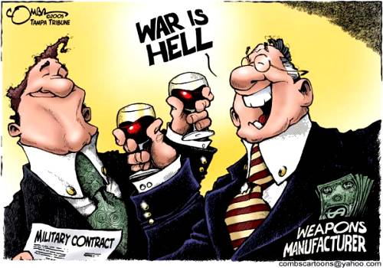
WAR: WHO BENEFITS, WHO PAYS?

Slide 3
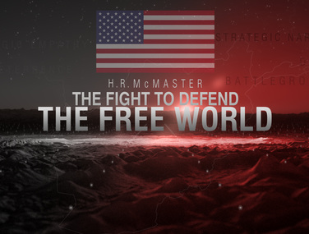
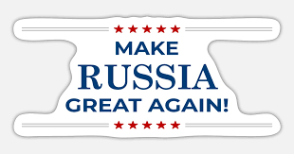
IDEOLOGIES AND PROPAGANDA
CONVINCE TAXPAYERS
TO CONTINUE PAYING FOR WAR

Slide 4
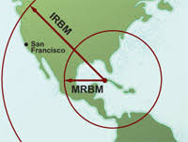
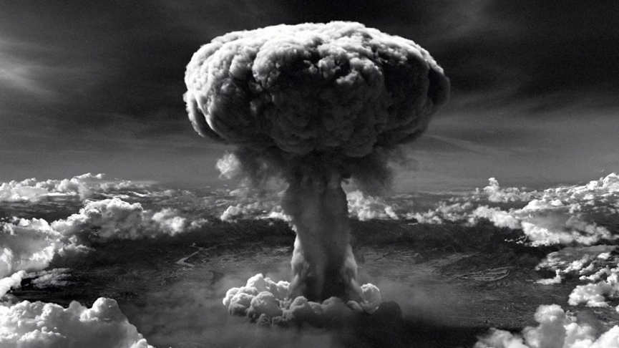
Stated vs. Actual Policy Rationales:
Why did they do it?
SOVIETS PUT MISSILES IN CUBA,
OCTOBER 1962
HIROSHIMA AND NAGASAKI
BOMBINGS, AUGUST 1945

Slide 5
Stated vs. Actual Policy Rationales:
Why did Putin invade Ukraine? (February 2022)
STATED
ACTUAL
Putin’s July 2021 article, “On the Historical Unity of Russians and Ukrainians”
Historian Jane Burbank concludes, “The goal, plainly, is empire.”
Was Putin’s goal really to restore the Russian Empire?
Was it to defend Russia from NATO expansion?
Was it something else?

Slide 6
Putin’s Intentions:
Why Public Statements Alone Tell Us Little
Like all politicians, Putin says different things to different audiences.
Sometimes he has said that NATO expansion threatens Russia, other times not.
American pundits cherry pick his statements to support their own positions (e.g. Michael McFaul, John Mearsheimer).
Need objective evidence, not just public statements, to understand Kremlin policymakers’ real intentions in invading Ukraine.

Slide 7

Which came first, the Chicken or the Egg?
Is NATO defending itself from Russia, or is Russia defending itself from NATO?
Aleksandr Dugin’s The Foundations of Geopolitics (1997).
But do Kremlin planners embrace Dugin’s ideas?
Can’t discern policy intentions only from official statements or ideological books; need objective evidence.

Slide 8
U.S. and NATO’s Intentions:
Defending Ukraine and Liberal Democracy?
NATO began expanding in March 1999 (to Poland, Hungary, and Czech Republic), before Putin took office.
NATO expanded further in 2004 (to Estonia, Latvia, Lithuania, Romania, Slovakia, Slovenia, and Bulgaria), long before Russia’s 2014 annexation of Crimea.
Since World War II, the US has used force or the threat of force to support dozens of governments throughout the world, mostly right-wing dictatorships, not liberal democracies.
These actions speak louder than words; claims about defending liberal democracy from Russian aggression merit critical examination.

Slide 9
MILITARY SPENDING TELLS THE STORY
US/NATO AND RUSSIAN MILITARY EXPENDITURES,
2020 US DOLLARS (billions), 1992-2021 from SIPRI Military Expenditure Data Base
1200
1000
800
600
400
200
0
US/NATO
RUSSIA
1992 2002 2012 2022

Slide 10
Russian Imperialism: Fantasy, not Reality
In 1998, the US and NATO spent 585 billion dollars more on their militaries than Russia. By 2021, this already absurd level of overkill had increased to 873 billion.
Aleksandr Dugin’s dreams of a Russian “world empire” were simply delusional. This was common knowledge in Washington, Brussels [NATO headquarters], and Moscow.
There was no conceivable security rationale for the expansions of NATO in 1999 and 2004; they were entirely unprovoked.
The US and NATO could have made peace with Russia at any time since the end of the Cold War, and can still make peace today.

Slide 11
Historical Background of the Ukraine War
1992-1999: Post-Cold War “peace dividend;” Yeltsin turns over Russian economy to Wall Street and oligarchs.
Beginning in 1999, American weapons makers and foreign policy hawks end the peace dividend and begin a twenty-year military buildup and NATO expansion to restore their profits and power.
Beginning in 2000, newly elected Vladimir Putin reasserts state control over the Russian economy, earning popular support but the enmity of US and European elites.
Russia struggles to keep up with the US/NATO military buildup, but falls further behind.

Slide 12
MILITARY SPENDING TELLS THE STORY
US/NATO AND RUSSIAN MILITARY EXPENDITURES,
2020 US DOLLARS (billions), 1992-2021 from SIPRI Military Expenditure Data Base
1200
1000
800
600
400
200
0
US/NATO
RUSSIA
1992 2002 2012 2022

Slide 13
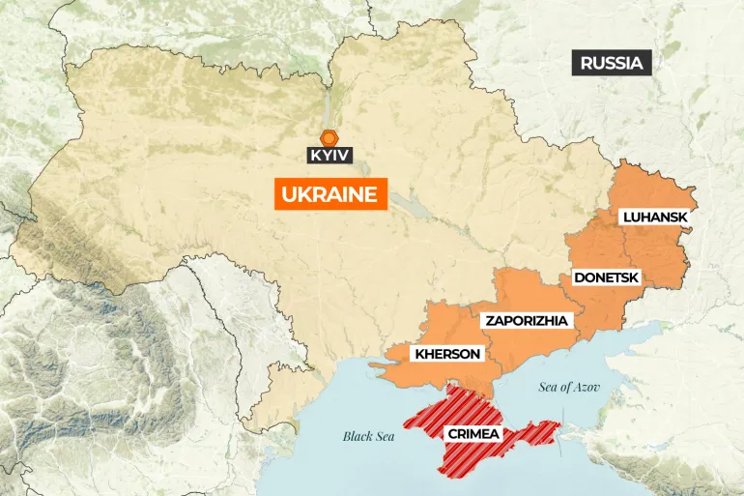
Ukraine, with Provinces Annexed by Russia

Slide 14
Antecedents of Russia’s February 2022 Invasion
In 2014, the US supports an anti-Russian coup in Kyiv.
Ukrainian civil war: western and central Ukraine support the coup while the Donbas and Crimea oppose it.
Russia supports separatists in Donbas and annexes Crimea, home of its Black Sea Fleet.
In 2019, Volodymyr Zelensky is elected President of Ukraine on a pro-EU and pro-NATO platform.
In November 2021, U.S. and Ukraine sign Charter on Strategic Partnership, calling for Ukraine to join NATO and reintegrate Crimea into Ukraine.

Slide 15
Why the Conflict Continues
It appears the Kremlin’s war aims are to retain Crimea; insure at least a neutral (not EU/NATO-aligned) government in Kyiv; and retain the four southeastern provinces annexed in September 2022.
Kyiv’s stated aim is to regain all provinces annexed by Russia, including Crimea. The Pentagon knows this is not realistic, but Kyiv will not accept a negotiated end to the war as long as Europeans and Americans continue arming Ukraine with no requirement to settle the conflict.
US policy is to “fight Russia to the last Ukrainian” in the hope of toppling Putin; but the war is having the opposite effect, enabling Putin to further consolidate his power.

Slide 16
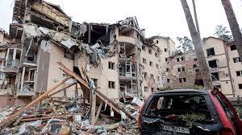
How will the War End?
No one has a crystal ball, but it’s likely that European and American taxpayers will get tired of paying for the war before Russia abandons it’s war aims.
A negotiated end to the war may include continued Russian annexation of Crimea, neutrality of Ukraine, and a new referendum giving the recently annexed provinces the choice to join Ukraine or Russia.

Slide 17
What Should We Learn from this War?
That war is obsolete. If citizens want peace, then demand that our leaders resolve conflicts through negotiations, not war.
That war propaganda is seductive. Don’t believe politicians and pundits who whip up indignation about a war in order to give our tax dollars to military bureaucracies and “defense” contractors.
That war institutions are entrenched but depend upon public support. If citizens want peace, then demand that policy-makers “move the money” from the war machine to investment in a just and sustainable future.

Slide 18
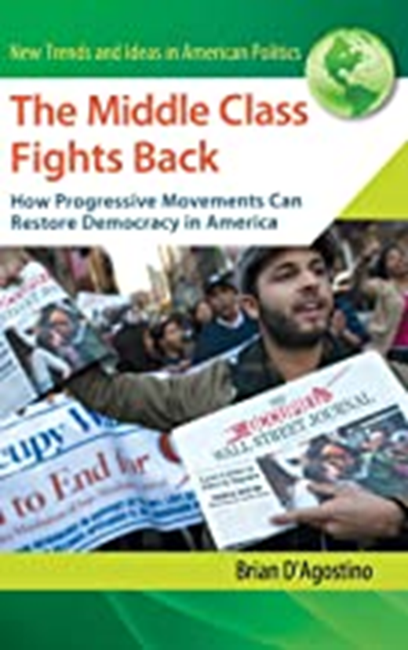
Bibliography
bdagostino.com
Scholarly citations in support of this presentation appear in the text version, “Ukraine, Ideology, and Military Spend-ing: Rethinking International Security,” currently under peer review by Peace Studies Journal. For a copy of this paper and the PowerPoint, contact Brian D’Agostino at bdagostino2687@gmail.com

