Slide 1
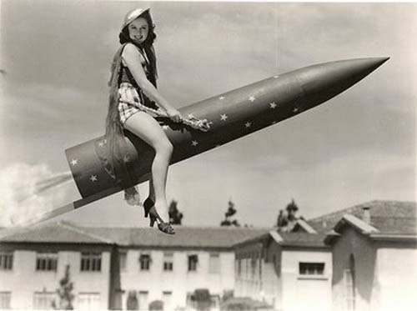

UNDERSTANDING THE UKRAINE WAR:
NATO AND THE PSYCHOLOGY OF MILITARISM
Brian D’Agostino, Ph.D. bdagostino.com

Slide 2
I. Dynamics of the Ukraine war
US and European claims that Russia’s 2022 invasion of Ukraine was “unprovoked” falsify the historical record
Such claims serve to legitimize NATO expansion and tens of billions of dollars of arms transfers to Ukraine
What was really unprovoked is NATO expansion itself
“Washington gaffes” reveal the truth—Fiona Hill, NATO Secy General Jens Stoltenberg

Slide 3
II. NATO expansion is not a rational policy
It first occurred in 1999 and 2004, long after collapse of the USSR and long before Russia’s 2014 annexation of Crimea
Prior to Russia’s 2022 invasion, the US and NATO were outspending Russia 30 to 1 on war preparations, including NATO expansion
NATO expansion was part of a package of other militarist policies undertaken at the same time—cancellation of security treaties with Russia, nuclear weapons modernization, efforts to maintain military domination of China, opposition to demilitarizing the Middle East.

Slide 4
III. Irrational policies require psychohistorical explanations. My 1990 survey of the Council on Foreign Relations (see D’Agostino, 2023) reveals the psychology of militarism:
Hawks outnumber doves in my sample by 2 to 1 (actual ratio in US foreign policy establishment is probably higher because my mentor was a dove, biasing response rate against hawks)
Male hawks exhibit machismo and authoritarianism; to them, military power symbolizes vigorous masculinity, and freedom and power of the abusive parent
Female hawks exhibit authoritarianism
Findings challenge “rational choice” models of international relations, in which policy elites act on cost-benefit analyses

Slide 5
IV. Changing the World: Parenting Education
D’Agostino (2023), pp. 337-338
H. van de Rijt and F. Plooij (2017), The Wonder Weeks
Home visiting programs for post-partum doulas and pediatric nurses (to support healthy attachment and parents’ capacity for mentalization/reflective function).
M. Kind (2014), “Teaching Parenting in Schools” Psychohistory News Vol. 33, No. 3 (Summer) psychohistory.us
PEPS Magazine (in French); supports positive parenting regardconscient.net/newsletter/accueil-peps.html
Parents First!, an educational organization that supports parenthood parentsfirst.net

Slide 6
V. Changing the World: Demilitarization
D’Agostino (2024), pp. 11-12
Implications for ending Ukraine war: need to demilitarize Europe and Russia in the security interests of both
Verifiable arms reduction agreements are a tested and effective path to international security; “verifiable” means they don’t depend only on trust
The notion that arms reductions cannot work is contradicted by historical experience. Examples: US/Soviet arms control; Chemical Weapons Convention; Anti-Personnel Mine Ban Convention.

Slide 7
Bibliography
Abelow, Benjamin (2022). How the West Brought War to Ukraine. Siland Press: Great Barrington, MA.
Abelow, Benjamin (2025). (Fiona Hill and Jens Stoltenberg quotes) Comments in Radio Roma conference on Ukraine, Disarmament Times, March 2025.
D’Agostino, Brian (2023). Interdisciplinary Handbook of Perceptual Control Theory, Chapter 14, “Sources and Dynamics of the Self: PCT, Psychoanalysis, and the Control of Self-Image,” Elsevier: Cambridge, MA. bdagostino.com
D’Agostino, Brian (2024). Ukraine, Ideology, and Military Spending: Rethinking International Security. Peace Studies Journal, vol. 16, issue 2, February. bdagostino.com

Slide 8
UNDERSTANDING THE UKRAINE WAR:
NATO AND THE PSYCHOLOGY OF MILITARISM
Brian D’Agostino, Ph.D. bdagostino.com

