Slide 1
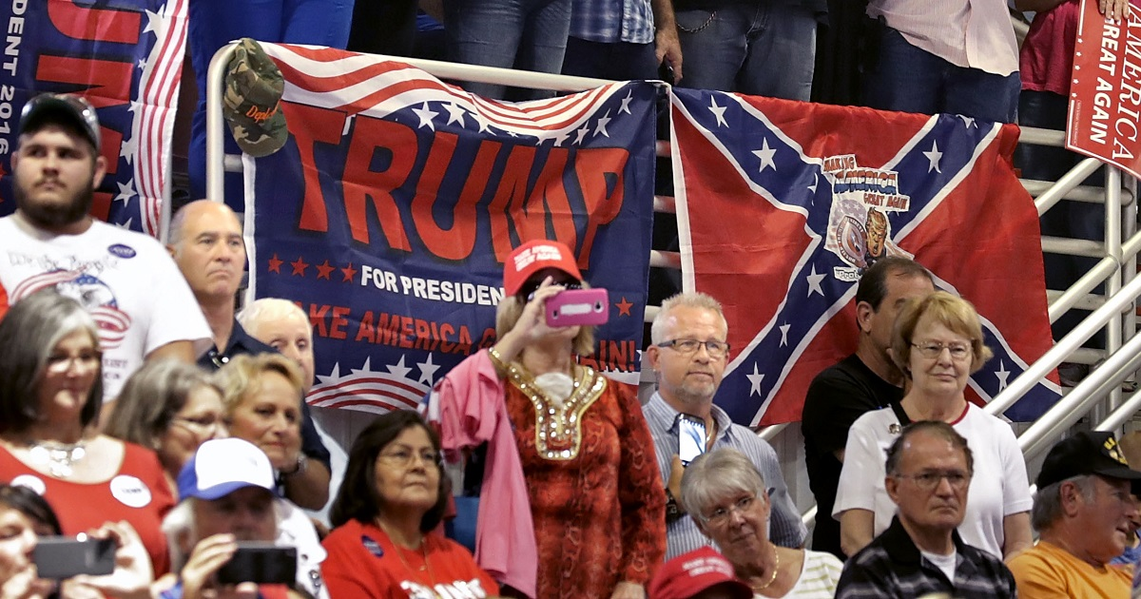
White Poverty: Class and the Social
Construction of Race in the United States
Brian D’Agostino, Ph.D. bdagostino.com

Slide 2
Who is Poor in the US?
More than 40% of Americans
Greatly undercounted by Official Poverty Measure (OPM), which neglects many categories of inflation (especially rent) since 1960s
Less than $60,000 annual income (family of four)

Slide 3
Who is Poor in the US?
No net worth or negative net worth (debt)
Cannot meet basic monthly expenses if they had a $400 emergency
More than 130 million Americans
  45 million (35% of 130) are Black, Latino or Native
  85 million (65% of 130) are White or Asian

Slide 4
Re-election of Donald Trump
White Americans who voted in 2024
  6 in 10 voted for Donald Trump
  4 in 10 voted for Kamala Harris
Two major factors explain US presidential elections
  Current state of the economy; high inflation favored Trump
  Ideology and party identification
Economic distress and racial politics together elected Trump

Slide 5
History of Racial Politics in the U.S.
Three centuries of Black slavery (1565 to 1865) and Native American genocide
Waves of racial liberation and backlash
  Reconstruction (1867 to 1877) followed by Jim Crow (1880s to 1950s)
  Civil Rights Movement (1950s to 1960s) followed by Republican Southern Strategy and realignment (1960s to 1980s)
  Obama Administration (2008-2016) followed by Tea Party backlash and MAGA (2010 to present)
  Poor People’s Campaign (2017 to present)

Slide 6
Reactionary and Liberal White Americans
Lloyd deMause’s “psychoclasses” and George Lakoff’s “strict father” vs. “nurturing parent” types
Punitive parenting (“strict father”) creates repression of anger and displacement onto scapegoats including racial minorities (Milburn and Conrad’s Raised to Rage, 2016; cited in D’Agostino, 2023)
Nurturing parenting and healing of childhood trauma enable a politics of solidarity and racial inclusion.

Slide 7
Social Change Through Parenting Education
D’Agostino (2023), pp. 337-338
H. van de Rijt and F. Plooij (2017), The Wonder Weeks
Home visiting programs for post-partum doulas and pediatric nurses (to support healthy attachment and parents’ capacity for mentalization/reflective function).
M. Kind (2014), “Teaching Parenting in Schools” Psychohistory News Vol. 33, No. 3 (Summer) psychohistory.us
PEPS Magazine (in French); supports positive parenting regardconscient.net/newsletter/accueil-peps.html
Parents First!, an educational organization that supports parenthood parentsfirst.net

Slide 8
Confronting Plutocracy, Militarism, and Austerity
Trump’s May 2025 “Big, Beautiful Bill”
  Plutocracy: Massive tax cuts for the rich
  Militarism: Increases to already bloated military spending
  Austerity: Cuts to Medicaid, food assistance, and education; will devastate millions of poor Americans of all races
Tax cuts and military spending, even with austerity, will bankrupt the state (c.f. French ancien regime in 1789)

Slide 9
Towards a New Political-Economy
Cause of poverty and increasing wealth inequality: A political-economic system in which enterprises are owned by external stockholders, not workers and stakeholders
This property system concentrates wealth (c.f. board game Monopoly) and political power
Viable alternative: worker-owned enterprises (c.f. Mondragon Cooperative Corporation, Spain)
New fiscal priorities: tax the rich, cut back bloated war economy, public investment in green economy and general prosperity

Slide 10
Bibliography
Barber, William J. (2024). White Poverty: How Exposing Myths about Race and Class can Reconstruct American Democracy. W. W. Norton & Company, New York: NY.
D’Agostino, Brian (2012), The Middle Class Fights Back: How Progressive Movements Can Restore Democracy in America. Praeger, Santa Barbara, CA.
D’Agostino, Brian (2023). Interdisciplinary Handbook of Perceptual Control Theory, Chapter 14, “Sources and Dynamics of the Self: PCT, Psychoanalysis, and the Control of Self-Image,” Elsevier: Cambridge, MA. bdagostino.com
Ehrenreich, Barbara (2001/2010). Nickel and Dimed: On (Not) Getting By in America. Metropolitan Books, New York: NY.

Slide 11
White Poverty: Class and the Social
Construction of Race in the United States
Brian D’Agostino, Ph.D. bdagostino.com

